Slide 1

The Kotlin
programming language
2023-24

Slide 2
Introduction and history
Statically typed programming language for modern multi-platform applications
https://kotlinlang.org/
Largely inspired by functional programming techniques
Higher order functions, closures, immutability, algebraic types, functors, monads, …
Took sensible ideas from various sources
C#, Javascript, Scala, Groovy, Java, Haskell, …
It targets several platforms
JVM, Android, browser (Javascript), native
Development tools
IntelliJ IDEA, Android Studio, Eclipse, CLI, …

Slide 3
The Kotlin timeline
July '11
Project Started
November '17
Kotlin 1.2
November '21
Kotlin 1.6.0
December '23
Kotlin 1.9.22
June '13
IntelliJ Idea integration
October '18
Kotlin 1.3
June '22
Kotlin 1.7.0
February '16
Kotlin 1.0
August '20
Kotlin 1.4.0
December '22
Kotlin 1.8.0
March '17
Kotlin 1.1
May '21
Kotlin 1.5.0
July '23
Kotlin 1.9.0

Slide 4
Playing around with Kotlin
An online REPL interface is available as a playground
https://play.kotlinlang.org/
It allows to easily experiment with the language constructs and see the differences among the various versions of the language and of the target platform
JVM, JVM + JUnit, Javascript, Javascript Intermediate Representation (IR), JS Canvas, …
https://proandroiddev.com/introducing-the-kotlin-playground-e3625c05a109
It is possible to share the code created with the playground with other people and to host it in third-party sites

Slide 5
The Kotlin type system
Kotlin is a statically typed language
Variables, temporaries, function parameters and return types are labelled with the type of the value they can be assigned to
A powerful type inference system is used by the compiler in order to make deductions and detect possible errors as soon as possible
As well as saving the programmer from explicitly declare types whenever it is possible to deduce them from the context
Variables and functions can be annotated with an explicit type in case of ambiguities
No type system violations are possible in any case

Slide 6
Primitive types
Differently from the Java language, where a set of primitive types (int, short, long, byte, float, double, char, boolean) complements the classifier types, Kotlin does not have such a distinction
Kotlin is only based on the corresponding boxed type (Int, Short, Long, Byte, Float, Double, Char, Boolean), thus having reference semantics for every type
This largely simplifies the type hierarchy, avoiding "strange" duplications and inconsistencies in parameter passing and variable assignments
However, the compiler internally optimises the actual data type, whenever possible, reducing the actual overhead due to boxing and heap based allocation and guaranteeing the same level of efficiency provided by the Java language

Slide 7
Null safety
Although every value can be regarded as a reference, Kotlin explicitly distinguishes nullable types by their non-nullable counterpart
Nullable types have their name followed by '?', while non-nullable ones do not
val s: String = null results in a compile error, since the type String is non-nullable
All non-nullable variable must be explicitly initialized before being used
Since the Java default of assigning them null values is not applicable
In the type inheritance hierarchy, the class Any is the root of every non-nullable class
While Any? is the root of all the nullable ones
Class Nothing, represents the bottom
It inherits from every other class, but there exist no instance of it
Class Nothing? inherits from every nullable class: its only instance is the null keyword

Slide 8
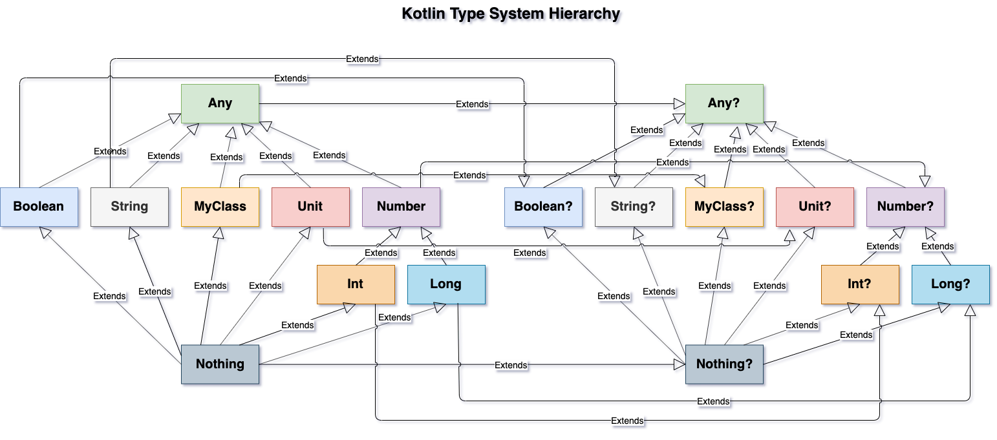
Kotlin type system hierarchy

Slide 9
Using nullable types
It is not possible to assign null values to non-nullable variables
The compiler will prevent it
It is mandatory to write null-safe code when accessing a nullable variable
The language offers special constructs to simplify code writing, while keeping expressivity and readability
The safe-call operator (?.) must be used to access a property or a method of a nullable value
It resolves to the usual call operator (.) if the value to which is applied is not null, otherwise it immediately returns null
The elvis operator (?:) can be used to provide an alternative value (else) if its left-hand side is null
The pretend-not-null operator (!!) throws a runtime exception if its left-hand-side is null

Slide 10
Using nullable types
var a: String = "abc"
// a = null // compilation error
var b: String? = "abc"
b = null //ok
var len: Int? = b?.length // len: null
var c: String = b ?: "default" // c: "default"
var len2:Int = b!!.length // Null-Pointer Exception

Slide 11
The Unit type
In Kotlin everything has a type
Expressions that do not return anything have the special type named Unit
It represents the value that is returned by an expression that does not explicitly returns anything else (this would be called void in Java or in C/C++)
Unit is at the same type both a type and a value
Unlike void, Unit is a real class (Singleton) with only one instance, the Unit object
Functions that return no value (procedures) have Unit as a return type in their declaration
However, it may be simply omitted, since the compiler will assume it as a default
https://dzone.com/articles/kotlin-pearls-7-unit-nothing-any-and-null

Slide 12
Variables and values
A variable is a named storage location used to store data that can be modified during program execution
In kotlin, variables have a static type, and only values that conform to that type can be stored inside them
Kotlin distinguishes between reassignable variables and final ones
The former are introduced by the var keyword and can be bound to different values during their lifetime
The latter are introduced by the val keyword and, once bound to a value, cannot be reassigned to anything else
Warning: a final value is not, by itself, immutable!
If what is stored inside has a (mutable) state, it may evolve, even if the symbol is declared as val

Slide 13
Variables and values
var age: Int = 25
age = 26 // value of age is changed from 25 to 26
val name: String = "John"
// name = "Jane" // Error: val cannot be reassigned
var x = 10 // type of x is inferred as Int
val y = "Hello" // type of y is inferred as String
val seq: CharSequence = "Jane" // this works because a String is also a CharSequence
val l: MutableList<String> = mutableListOf() // l is an empty mutable list
l.add(name) // now l contains ["John"]
l.add("Jane") // now l contains ["John", "Jane"]

Slide 14
Function types
Kotlin type system also supports function types
I.e., types that define values that are invokable
The notation ( Int, Int ) -> Double denotes a function type that receives two integer arguments and returns a double
The notation () -> String denotes a function that has no arguments and returns a String
Function types can be instantiated with regular functions, function literals, and lambda expressions
Function types are a powerful feature of Kotlin that can be used to define functions as values, making it easy to pass them around as arguments or return them from other functions
They are commonly used in functional programming and can be used to create code that is more modular, flexible, and expressive

Slide 15
Named functions
Named functions are functions that have a name that can be used to call them
They are defined using the fun keyword followed by the function name and the function body
The function body may contain arbitrary statements and may return a value
fun greet(name:String) { println("hello, $name") }
A named function is invoked using its name and passing in the required arguments
greet("Alice") // hello, Alice
They are the most common type of function in Kotlin, and are used to define reusable blocks of code that can be called from different parts of a program
When a named function is used to instantiate a function type, its name is preceded by ::
val f: (String) -> Unit = ::greet

Slide 16
Function parameters
They specify the types and number of arguments that a function accepts
They appear inside parentheses () after the function name, and separated by commas
Function parameters can have default values
This allows the function to be called with fewer arguments, if the default values are acceptable
Function parameters can be named when calling functions
This is very convenient when a function has a high number of parameters or default ones
fun reformat(str: String, // Mandatory
normalizeCase: Boolean = true, // Optional
wordSeparator: Char = ' '): String { … } // Optional
reformat("Hello Kotlin!", wordSeparator = '_')

Slide 17
Function body
Kotlin functions can contain a wide variety of statements, which allow you to define the logic and behavior of your program
Assignment statements (=)
Expression statements (function calls, operators, and literals)
Control flow statements (if, else, when, repeat, for, while, and do-while)
Loop control statements (break and continue)
Exception handling statements (try, catch, and finally blocks)
Return statement (return)
Assertion statement (assert)
Most of them behave in similar way to the corresponding statements in Java, but there are some notable exceptions

Slide 18
Control statements
The if clause is an expression: each branch returns a value
val max1 = if (a > b) a else b
If a branch contains a block, the last value of the block is returned
val max1 = if (a > b) { println(a); a } else { println(b); b }
The when clause replaces the switch construct of Java
The compiler forces to control all possible alternatives
It can also be used with ranges, collections, and other types of expressions
It is also possible to write it without an argument to match against arbitrary conditions

Slide 19
Control statements
fun describeNumber(num: Int): String {
return when (num) {
0 -> "Zero"
1 -> "One"
2 -> "Two"
else -> "Other" //mandatory!
}
}
println(describeNumber(1)) // → "One"
println(describeNumber(7)) // → "Other"
fun describe(obj: Any): String =
when {
obj is String && obj.length < 10 ->
"Short string"
obj is String && obj.length >= 10 ->
"Long string"
obj is List<*> -> "List (${obj.size})"
else -> "Other"
}
println(describeLength("Hello"))
// → "Short string"
println(describeLength(listOf(1,2)))
// → "List (2)"

Slide 20
Loops and iterators
The for statement only operates with iterators, ranges, or iterables
The traditional, C-like, syntax has been removed
val iter = intArrayOf(1,2,4,8,16,32,64).iterator();
for (item in data)
println(item)
for (i in 1..10) // inclusive range
println(i)
val array = arrayOf("a","b","c")
for ( (index, value) in array.withIndex() ) // iterable
println( "array[${index}]: ${value}")

Slide 21
Function literals
A function literal consists of an anonymous fun block
To be used, it must be assigned to a variable
val sum = fun(a:Int, b:Int) { return a + b }
A function literal is invoked via the variable it is bound to
val result = sum( 5, 3 ) // 8
Function literals allow to define anonymous functions on the fly, making the code more concise and expressive
They are commonly used to pass behavior as an argument to higher-order functions, or to create small, self-contained functions that perform a specific task

Slide 22
Lambda expressions
Lambda expressions are a more concise way to define anonymous functions
They are enclosed in braces and use the -> operator to separate the parameter list from the body
val l1 : (Int) -> Int = { n -> n+1 }
If lambda has only one parameter, it can be omitted together with the -> operator, and can be referred to using the name it
val l2 : (Int) -> Int = { it + 1 }
Similarly to function literals, lambda expressions automatically create closures when they reference variables that are in scope where they are defined
Powerful feature used in connection to of higher order functions

Slide 23
Trailing lambdas
If the type of the last parameter of a function is a function itself, and if the invoker is going to supply a lambda function as argument, then it is legal to move the lambda expression outside of the function call parentheses
This approach is used extensively in many Kotlin libraries and APIs, and it is an essential part of the language's functional programming capabilities
fun combine(a: Int, b: Int, operation: (Int, Int) -> Int): Int {
return operation(a, b)
}
val result = combine(5, 10) { x, y -> x + y } // → 15

Slide 24
Higher order functions
Functions can receive other functions as parameters or return them as values
Typical pattern used by functional-programming paradigm
HOFs make code more concise and expressive
Since they allow to pass behavior (in the form of functions) as arguments to other functions, or to return a behavior (function) that conditionally depends on received arguments
HOFs are extremely powerful, and can be used to implement various design patterns
such as the strategy pattern, the observer pattern, and the decorator pattern, among others

Slide 25
Closures
Closures are functions that capture the state of its surrounding environment, including any variables or objects that are in scope
In Kotlin, closures are created automatically when lambda expressions or function literals reference variables from the enclosing scopes
The life-cycle of the captured variable is thus extended: as long as the closure exists, the captured variable remains accessible, even if the function where it was defined returned
fun createGenerator(): () -> Int {
var c = 0
return { ++c }
}
val g1 = createGenerator()
val g2 = createGenerator()
println( g1() ) // 1
println( g1() ) // 2
println( g2() ) // 1
println( g2() ) // 2

Slide 26
User defined types
Classes
Kotlin fully supports the object-oriented paradigm and provides a set of built-in classes with a single inheritance hierarchy
More classes can be defined as extensions of existing ones
If no parent class is specified, the compiler automatically assumes the built-in class Any as a parent class
A class encapsulates constructors, methods, and properties
Several variations of the class concept are provided
Abstract classes, data classes, sealed classes, singleton objects, …
Interfaces
An interface introduces a new abstract type, declaring a set of methods and properties to be implemented
Interfaces may be organised in a multiple (zero or more) inheritance hierarchies among themselves

Slide 27
Classes
The class keyword introduces a new class
Classes have a primary constructor and zero or more secondary constructors
class Person constructor(val name: String) {
constructor(name: String, parent: Person) : this(name) {
parent.children.add(this)
}
constructor(name: String, parent: Person, age: Int): this(name) {
parent.children.add(this)
this.age=age;
}
var children: MutableList<Person> = mutableListOf<Person>(); var age = 0;
}

Slide 28
Constructors
The primary constructor is part of the class header
Its parameters prefixed by val or var are automatically promoted to properties
No initialization can happen inside it: if necessary, an init block must be provided
Init blocks are run in declaration order after the primary constructor is finished
If it has no annotations or visibility modifiers, the constructor keyword may be dropped
Secondary constructors are introduced by the constructor keyword
They must always delegate to the primary one before any extra action can take place inside the curly braces
If a new instance has been created using a secondary constructor, the code block associated with the invoked constructor is executed last

Slide 29
Constructors
class Segment(val start: Point, val end: Point) {
val length: Double = sqrt(
(end.x - start.x).toDouble().pow(2.0) + (end.y - start.y).toDouble().pow(2.0))
// initializer block
init {
println("Point starting at $start with length $length")
}
// secondary constructor
constructor(x1: Int, y1: Int, x2: Int, y2: Int): this(Point(x1, y2), Point(x2, y2) {
println("Secondary constructor")
}
}
val s = Segment(1,2,3,4)
// >>>>>>>>
Point starting at Point(x=1, y=2) with length 2.8284271247461903 //the properties length and start are initialized with their constructor-supplied value since the primary constructor is run before the init block
Secondary constructor //the init block is run before the code block associated with the secondary constructor

Slide 30
Properties
Each class can declare zero or more properties that are used to store and represent data within instances of that class
They can be read/write (introduced by the var keyword) or read/only (introduced by the val keyword)
The compiler automatically generates hidden fields, to store the value of each property, as well as a set of getters and setters function, to manipulate their content: val properties only have a getter
Getters and setters can be explicitly overriden, if necessary
By adding an extra get() or set(...) block after their declaration
This allow to create computed properties as well as to delegate their behaviour
By default, all properties are public
But their visibility can be restricted to private, protected, or internal

Slide 31
Inner fields
No fields can be declared by the programmer to back properties up
They are automatically handled by the compiler
If needed, an accessor function may refer to the backing field, by using the field keyword
The field identifier has a special meaning only within the custom getter and setter, where it refers to the backing field that contains the property’s state
class Document(_summary: String) {
var summary: String = _summary
set(value) { field = value; hashCode = computeHash() }
var hashCode: Int = computeHash()
private set
private fun computeHash(): Int { println("Hashing..."); return summary.hashCode() }
}
val d = Document("abc") // → Hashing… d.summary = "qwerty" // → Hashing…

Slide 32
Properties
class Circle(var radius: Double) {
val area: Double
get() = Math.PI * radius * radius
}
val c = Circle(2.0) // Instantiates a circle with radius 2.0
c.radius *= 0.5 // modifies the radius property, setting it to 1.0
println(c.area) // access the (computed) property area and prints 3.141592…

Slide 33
Visibility modifiers
public
The default visibility modifier in Kotlin.
A public class, member or top-level function can be accessed from anywhere in the program
private
A private class, member or top-level function can only be accessed from within the same file or class that defines it
protected
A protected member can be accessed from the same class or its subclasses, but not from outside the class hierarchy
internal
An internal class, member or top-level function can be accessed from any class or file within the same module
A module is a set of Kotlin files that are compiled together

Slide 34
Lateinit var properties
The value of a variable may not be available at the object construction time
Declaring a variable as lateinit allow the compiler not to complain that its missing an initialization
The variable must be mutable because it will be assigned a value, later
If the variable is accessed before it’s initialized, an UninitializedPropertyAccessException is thrown
class MyActivity: Activity(){
private lateinit var button: Button //this will be initialized later
override fun onCreate(bundle: Bundle?) {
super.onCreate(bundle)
button = Button(this) //initialization occurs here
}
}

Slide 35
Delegates
Usually, properties are automatically stored inside class instances in hidden fields
If some common behaviour need to be applied, code tends to repeat
Kotlin address the case via delegated properties
The keyword by is used in the property declaration to define a delegate
The Kotlin class library offers some ready made delegates that are function responsible for getting and setting the value of the property
Lazy properties store a value that is computed only on first access
Observable properties invoke a listener whenever the value changes
Vetoable properties let a listener decide whether a value should be stored or not in the property

Slide 36
Lazy properties
lazy() is a function that takes a lambda and returns an instance of Lazy<T> where T is the type returned by the lambda
The first call to get() executes the lambda and remembers the result
Subsequent calls return the remembered value
val lazyValue: String by lazy {
print("computed!")
"Hello"
}
fun main() {
println(lazyValue) // → computed!Hello
println(lazyValue) // → Hello
}

Slide 37
Observable properties
Delegates.observable() implements the observable pattern
It takes two arguments: the initial value and a lambda, which will be invoked after any assignment is performed
The lambda has three parameters: the property being assigned to, the old value and the new one
class User {
var name: String by Delegates.observable("<no name>") {
prop, old, new -> println("$old -> $new")
}
}
fun main() {
val user = User()
user.name = "first" // <no name> -> first
user.name = "second" // first -> second
}

Slide 38
Custom delegates
class Example {
private val p$delegate = MyCustomDelegate()
var p: String
get() = p$delegate.getValue()
set(value:String) =p$delegate.setValue(value)
}
class Example {
var p: String by MyCustomDelegate()
}
class MyCustomDelegate {
operator fun getValue(thisRef: Any?, property: KProperty<*>): String {
// compute the value…
}
operator fun setValue(thisRef: Any?, property: KProperty<*>, value: String) {
// store the value…
}
}

Slide 39
Methods
Methods are functions defined within the scope of a class
They are used to define behavior for the instances of that class
Each method receive an implicit parameter, named this, that represent the instance the method is operating on
A method can be invoked on an object using dot notation
someObject.someMethod(param1, param2)
If a method implementation can be reduced to the evaluation of a single expression, its body can be replaced by the operator '=' followed by the expression
fun sum(a:Int, b:Int) = a + b

Slide 40
Operator overloading
Operator overloading is a feature that allows to redefine the behavior of operators such as +, -, *, and / for instances of a class
If class C overloads operator '+', and c1 and c2 are instances of C, it is legal to use expression c1 + c2
To overload an existing operator in Kotlin, a method with a suitable name must be defined inside the class
Such a method should be preceded by the operator fun keywords
class Vector2D(val x: Int, val y: Int) {
operator fun plus(other: Vector2D): Vector2D {
return Vector2D(x + other.x, y + other.y)
}
}
val res = Vector(1,2) + Vector(2,3) // → Vector(3,5)

Slide 41
Equality testing
In Kotlin, the equality operator == is used to compare the values of two objects
While the identity operator === is used to check whether two references point to the same object
This maps to the equals(other: Any?): Boolean method, which is available for each object since it is defined in the Any class and inherited by all classes
If two objects need to be equality-compared, a suitable overloaded implementation of equals(...) must be provided
It must be coherent with the general equality contract, guaranteeing the respect of the reflexive, symmetric, and transitive properties

Slide 42
hashCode()
The Any class also defines a hashCode() method, which is intended to provide a hash value that subsumes the object state
hashCode() and equals(...) must be defined coherently with each other
If two objects are equal, they should have the same hash code
The reverse is not true: two objects having the same hash code can be different
Whenever the equals(...) method is overridden, the hashCode() method must be overridden as well
Failure to do so will prevent the object from being compatible with some standard library containers, like Sets and Maps

Slide 43
Order testing
Primitive types can be compared using order operators (<, <=, >=, >) according to natural ordering
Numerical for numbers
Alphabetical for String
Other types can be compared using the same operators if they implements the Comparable<T> interface
operator fun compareTo(other: T): Int
The method must return:
Zero if this is equal to other
Any negative number if it's less than other
Any (strictly) positive number if it's greater than other

Slide 44
Singleton objects
Whenever a class is going to have one single instance, and the primary constructor has no arguments, it is possible to declare a singleton object
It is obtained replacing the class keyword with the object one, and keeping the remaining syntax
An object is similar to a regular class in that it can have properties, methods, and implement interfaces
It can be referenced to it by its name
object MySingleton {
private var _counter = 0
fun increment() { ++ _counter }
val counter = _counter
}
MySingleton.increment()
println(MySingleton.counter) // → 1
MySingleton.increment()
println(MySingleton.counter) // → 2

Slide 45
Companion objects
Properties and methods defined inside a class operate at the instance level
Each instance has its own values and they are referred to via the dot-notation applied to instances of the class
Sometimes it is necessary to define properties and behaviors that are shared amongst all the instances of the class
Java declares them as 'static'
In Kotlin, they are declared using the companion object keyword, and are accessed using the class name
class Person(val name: String, var age: Int) {
companion object {
val defaultName = "Unknown"
}
}
println(Person.defaultName) // → Unknown

Slide 46
Extension functions
An extension function is defined as a regular function, but with the class or interface that it extends as its receiver type
The function can then be called on any instance of that class or interface, as if it were a member function of that class or interface
Extension functions can be used to add new functionality to an existing class without having to modify the class's source code or subclass it
The compiler transforms the extension function into a regular named function having one more parameter named “this” which is bound to the receiver object
As such, the extension function has no access to the private member of the receiver and represent just a form of “syntactic sugar”, which - however - keep the code concise and expressive

Slide 47
Extension functions
// add a new method to the List class named “second()”
fun <T> List<T>.second(): T? {
return if (this.size >= 2) {
this[1]
} else {
null
}
}
val list = listOf("one", "two", "three")
val second = list.second() // → two

Slide 48

Inheritance
Kotlin classes are part of a single-parent inheritance hierarchy
The root of which is Any
Any roughly corresponds to Java Object, but it lacks some of its methods
To create a subclass, the : symbol is used as a prefix of the superclass name
If a class does not indicate a superclass, it defaults to Any
By default, classes cannot be extended
To allow extensions, a class should be declared with the open annotation
Moreover, if any method is to be overridden, they, too, must be preceded by the open keyword
In subclasses, overriding methods must be preceded by the keyword override

Slide 49
Inheritance
open class Base(val p: Int) {
open fun method1(): Int = p
fun method2(): String = "Cannot be overridden"
}
class Derived(p: Int) : Base(p) {
override fun method1(): Int = p*2
// override fun method2(): String = "Error" // method2 is final // and cannot be overridden
}

Slide 50
Inheritance
A class has a single superclass and may implement zero or more interfaces
Both the superclass and the interfaces are specified after the primary constructor, in a comma separated list
open class Rectangle(var width: Double, var height: Double) {
open fun draw() { /* ... */ }
}
interface Polygon {
fun area(): Double // interface members are 'open' by default
}
class Square(side: Double) : Rectangle(side, side), Polygon {
// Both draw() and area must be overridden:
override fun draw() {
super<Rectangle>.draw() // call to Rectangle.draw()
}
override fun area() = width*height
}

Slide 51
Data classes
A data class is a class that is designed to store data, and only has state but no behavior
The primary constructor should have at least one parameter
All primary constructor parameters should be marked either as val or as var
Data classes cannot be abstract, open, sealed or inner
Data classes are useful because they provide a lot of useful functionality "for free", since the compiler automatically implements several methods:
equals(...) and hashCode()
toString()
component1(), …, componentN()
copy(...)

Slide 52
Plain classes vs data classes
class Point( var x: Int, var y: Int)
val p1 = Point(1,1)
val p2 = Point(1,1)
println( "Same point? ${p1 == p2}" )
>>>> "Same point? false"
This definition of the Point class does not override the equals method, but refers to that of Point's base class, Any, which returns true only when an object is compared with itself

Slide 53
Plain classes vs data classes
data class Point( var x: Int, var y: Int)
val p1 = Point(1)
val p2 = Point(1)
println("Same point? ${p1 == p2}")
>>>> "Same point? true"
The new definition of Point as a data class automatically includes overrides for methods, as equals, whose implementation depend on the properties of the class.For example, the data class version of Point contains an equals method that is equivalent to this:
override fun equals(o: Any?): Boolean {
// If it's not a Point, return false. Note that null is not a Point
if (o !is Point) return false
return x == o.x && y == o.y
}

Slide 54
Enum classes
Enums are a way of creating a class that has a specified, static set of instances
The enums classes cannot subclassed, but can implement interfaces and can have constructors, properties, and methods
enum class GymActivity {
BARRE, PILATES, YOGA, FLOOR, SPIN, WEIGHTS
}
enum class HttpStatusCode(val value: Int) {
OK(200), CREATED(201), NOT_FOUND(404),
ACCESS_DENIED(403), INTERNAL_SERVER_ERROR(500)
}

Slide 55
Enum classes
Storing properties in enum classes provides a convenient and type-safe way to define a fixed set of constants associated to each possible value
By using an enum class, you can ensure that a variable or function parameter can only take on one of a fixed set of values, and any other value is considered invalid, thus making the code more robust
By having one or more properties associated with each value, you can guarantee that when that specific value is manipulated, you will access the right constants related to it
Enum classes are conveniently tested using the when expression
Since an enum has a known set of instances, Kotlin is able to determine that all possible values are covered as explicitly listed instances and allows the omission of the else clause
If, in the future, a new value is added to the enum set, a compile error will be flagged, to notify that a branch is missing

Slide 56
Enum classes
fun getSuccessfulCode(code: HttpStatusCode): Int? = when (code) {
HttpStatusCode.OK -> code.value
HttpStatusCode.CREATED -> code.value
HttpStatusCode.NOT_FOUND -> null
HttpStatusCode.ACCESS_DENIED -> null
HttpStatusCode.INTERNAL_SERVER_ERROR -> null
}

Slide 57
Sealed classes
Sealed classes do for types what enums do for instances: they indicate the compiler that a given base type has a certain, well-defined set of subtypes
Subclasses of a sealed class can only be declared in the same file as the sealed one
Because of this, the compiler knows exactly how many they are and the else branch can be removed from the when clause
sealed class Result
data class Success(val data: List) : Result()
data class Failure(val error: Throwable?) : Result()
fun processResult(result: Result): List = when (result) {
is Success -> result.data
is Failure -> listOf()
}

Slide 58
Sealed classes
A sealed class implements an Algebraic Data Type (ADT)
It is the sum of the types of the inner classes
Its domain is the union of the domains of each inner class
If an inner class has no attributes, it may be replaced by a data object
sealed class Optional<out T>
data class Some<out T>(val data: T) : Optional<T>()
data object None : Optional<Nothing>()
var o1: Optional = Optional.Some(10)
println( o1 ) // → Some(data=10)
o1 = None
println( o1 ) // → None

Slide 59

Generics
Generics is a programming paradigm that allows to define a class or a function that can work with different types of data
Without having to rewrite the code for each specific type
Functions, classes, interfaces, …, can be defined as depending on one or more type parameters, which are enclosed in angular brackets (< … >) and become part of the type name
Differently from what happens in other languages, in Kotlin (and in Java) the implementation of generic types is based on type erasure
This means that the type parameter information is not available at runtime because it is replaced by Any? (or Object, in Java) thus making the type capable to work with all other types, thanks to inheritance
At compile time, however, the type information is retained and used to check the validity of the program

Slide 60
Generic functions
A function that receives as parameter or returns a value of generic type T must be prefixed by the <T> annotation
T may be constrained to extend a given class or implement an interface by adding an upper bound after it, like <T: Runnable>
More complex constraints may be expressed using the where clause
fun <T> sort(l: List<T>) where T : CharSequence, T : Comparable<T> { … }
sort( listOf( "three", "two", "one" ) ) //ok
//String implements both Comparable<String> and CharSequence
// sort( listOf( 1, 2, 3 ) )
// Type mismatch: inferred type is IntegerLiteralType[Int,Long,Byte,Short] // but CharSequence was expected

Slide 61
Generic classes
A class may depend on generic types, too
The Kotlin syntax requires that type parameters have to be declared after the class name, before the primary constructor
A generic parameter may be prefixed with the in and out keyword to specify variance in generic types
Variance refers to the way in which the subtyping relationship between types is preserved or reversed when the types are used as type arguments
class Box<T>(private val content: T) {
fun getContent(): T {
return content
}
}
val b1 = Box("hello")
val b2 = Box(12)
val s: String = b1.getContent() // "hello"
val i: Int = b2.getContent() // 12
// val b = b1 is Box<Int>
Cannot check for instance of erased type: Box<Int>

Slide 62
Variance in generic classes
interface Source<out T> {
fun next(): T
}
interface Sink<in T> {
fun put(item: T)
}
The out keyword specifies that T is a covariant type parameter in Source
It means that Source<S> is a subtype of Source<T> if S is a subtype of T
Covariant type parameters can only appear in output positions
Such as the return type of a function or a property
The in keyword specifies that T is a contravariant type parameter in Sink
It means that Sink<S> is a subtype of Sink<T> if T is a subtype of S
Contravariant type parameters can only appear in input positions
Such as the parameter types of a function or a property setter

Slide 63
Variance in generic classes
Class Pipeline is invariant with respect to parameter T
This means that Pipeline<S> and Pipeline<T> are two unrelated classes, independently of any possible inheritance relationship between S and T
Invariant type parameters can appear in both input and output positions
class Pipeline<T>(private val source: Source<T>, private val sink: Sink<T>) {
fun start() {
while (true) {
val item = source.next()
sink.put(item)
}
}
}

Slide 64
Scoped functions
Scoped functions are functions that execute a block of code within the context of an object
They provide a way to give temporary scope to the object under consideration where specific operations can be applied, thereby, resulting in a clean and concise code
The standard library provides five ready-made scoped functions: they differ in purpose and in syntax
let…, run…, and with(…) executes a block of code on an object and returns the result, while apply… and also… modifies the object and returns it
let…, run…, apply…, and also… are extension functions of a generic type T, while with(…) is a regular function operating on a generic parameter T
run…, with(…), and apply… accept a block based on a lambda with receiver, while let… and also… have their block defined as a simple lambda

Slide 65
Scoped functions
var name: String? = null
// …name is updated…
// let is used to prevent a
// NullPointerException from occurring
name?.let {
println(it.reversed)
println(it.length)
}
class Car{ var name:String = "",
var maker:String = "" }
// apply is used to configure an object
val car = Car().apply {
name = "Panda"
maker = "Fiat"
}
var occurrences: MutableMap<String,Int> = …
var name: String? = null
// …name is updated…
// run is used to operate on a nullable object
val count = name?.run {
val c = (occurrences[this]?:0) + 1
occurrences[this] = c; c
}
val car = Car()
// configure car…
// with operates on a non-null object
with (car) {
println(name)
println(maker)
}

Slide 66
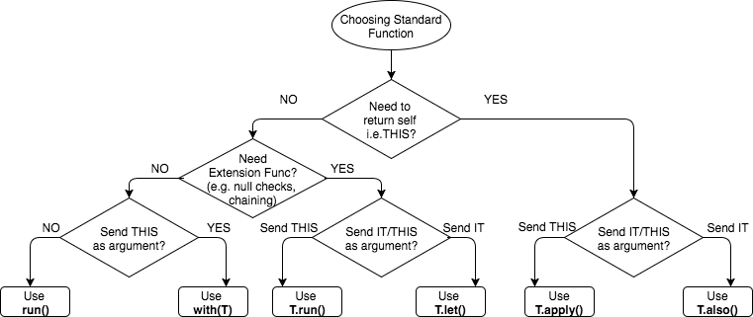
Choosing a scoped function

Slide 67
Type checking and casting
In some situations, it is necessary to assess the actual type of the value stored in a variable
Operator is (and its negated form !is) can be used to this purpose
var v: Any = …; if (v is String) { … }
A value can be casted to a different type using the unsafe as operator
It will throw an exception if the conversion is not possible
Alternatively, the as? safe cast operator can be used
It will return null if the conversion is not possible
The compiler tracks is-checks
It inserts safe casts on your behalf
This includes also negative checks & short circuiting

Slide 68
Smart casts
After an is-check, the compiler tries to automatically cast the checked variable to the verified class
This is called smart casting
Smart casting only applies if the compiler can guarantee that the field cannot be mutated since the is-check
val local variables – smart cast is always performed
val properties - if the property is private or internal or the check is performed in the same module where the property is declared, the smart cast is performed
var local variables – if the variable is not modified between the check and its usage and it is not captured in a lambda that may modify it, the smart cast is performed
var properties - the smart cast is never performed

Slide 69
The Kotlin collection library
Iterable<out T>
MutableIterable<T>
Array<T>
Collection<out T>
MutableCollection<T>
Map<K,out V>
List<out T>
Set<out T>
MutableSet<T>
MutableMap<K,V>
MutableList<T>
LinkedHashMap<K,V>
ArrayList<T>
LinkedHashSet<T>

Slide 70
Working with collections
The Kotlin Standard Library provides several helper functions to create and initialize collections
Immutable factories:
listOf(values...), setOf(values…), mapOf(values…), arrayOf(values…), listOfNotNull(collection), emptyList(), emptySet(), emptyMap()
Mutable factories:
mutableListOf(values...), mutableSetOf(values…), mutableMapOf(values…)
Moreover, a large set of manipulation methods is available
Providing support for filtering, grouping, mapping, and testing values inside the collection
These functions are designed to be easy to use and can help you write more concise and expressive code when working with collections

Slide 71
Filtering methods
filter(predicate: (T) -> Boolean): List<T>
returns a list containing only elements matching the predicate
filterNot(...) does the reverse
filterNotNull(...) removes all of the nulls from a collection
find(predicate: (T) -> Boolean): T?
returns the first element matching the given predicate, or null if none is found
val nums = listOf(10, 20, 100, 5)
val numbers = nums.filter { it > 20 } // → [100]
val divisibleByThree = nums.find { it % 3 == 0} // → null
val divisibleByFour = nums.find { it % 4 == 0} // → 20

Slide 72
Grouping methods
groupBy(keySelector: (T) -> K): Map<K, List<T>>
groups elements having the same key into a list and returns a map where each key is associated to its list
val numbers = listOf(1, 20, 18, 37, 2)
val groupedNumbers = numbers.groupBy {
when {
it < 20 -> "less than 20"
else -> "greater than or equal to 20"
}
}
// The variable groupedNumbers now contains a Map>. The map has two keys, “less than 20” whose value is [1, 18, 2], and “greater than or equal to 20” whose value is [20, 37]

Slide 73
Grouping methods
partition(predicate: (T) -> Boolean): Pair<List<T>, List<T>>
Splits the collection into a pair of lists: the first element contains all elements that satisfy the predicate, the second one contains all the others
fold(initial: R, operation: (R,T) -> R): R
Accumulates a value starting with initial and applying operation from left to right
r₀
op
r₁
op
r₂
op
r₃
op
r₄
op
r_{n-1}
op
r_{n}
t₁
t₂
t₃
t₄
…
t_{n}

Slide 74
Mapping methods
map(transform: (T) -> R): List<R>
Transforms all the elements of the collection by applying them the given function
It does not mutate the collection to which it is applied, but it returns a new list
mapIndexed(transform: (index: Int, T) -> R): List<R>
The transforming function is supplied with both the element and the corresponding index
mapNotNull(transform: (T) -> R?): List<R>
returns a list of all non-null outcomes obtained applying the supplied transform function to each element of the original collection
val doubles: List = listOf(1.0, 2.0, 3.0, null, 5.0)
val squares: List = doubles.mapNotNull { it?.pow(2) }
//squares = [1.0, 4.0, 9.0, 25.0]

Slide 75
Mapping methods
flatMap(transform: (T) -> Iterable<R>): List<R>
Applies a transformation function to each element of the original collection, and then flattens the resulting collections into a collection of plain values
val list: List> = listOf(listOf(1, 2, 3, 4), listOf(5, 6))
val flatList: List = list.flatMap { it.filter {v -> v%2 == 0} }
// The variable flatList will have the value [ 2, 4, 6].

Slide 76
Mapping methods
// example that returns a list of valid starting dates for employee records
// that have those starting dates stored as strings:
data class Hire(
val name: String,
val position: String,
val startDate: String )
fun getStartDates(l: List<Hire>): List<Date> {
val formatter = SimpleDateFormat("yyyy-MM-d", Locale.getDefault())
return l.mapNotNull {
try { formatter.parse(it.startDate) }
catch (e: Exception) { null }
}
}

Slide 77
Boolean methods
any(predicate: (T) -> Boolean) : Boolean
Will return true if the predicate evaluates true for any element in the collection
all(predicate: (T) -> Boolean): Boolean
returns true only if every element in the list matches the predicate
none() : Boolean
Returns true only if there the collection is empty
none(predicate: (T) -> Boolean): Boolean
returns true only if the predicate evaluates to true for none of the elements in the collection

Slide 78
Boolean methods
val nums = listOf(10, 20, 100, 5)
val isAny = nums.any() // true
val isAnyOdd = nums.any { it % 2 > 0 } // true
val isAnyBig = nums.any { it > 1000} // false
val areAllEven = nums.all { it % 2 == 0 } // false
val isNone = nums.none() // false
val isNone4 = nums.none { it == 4 } // true

Slide 79
Sequences
A Sequence<T> is an iterable container type that operate lazily, potentially allowing infinite elements
Similar to Java 8+ java.util.stream.Stream<T>
Applying operators to a a Sequence has no effect unless there is a final consumer
When a sequence undergoes a multi-step processing, elements are extracted and processed one-by-one
While collections such as lists, sets, and maps are eagerly evaluated, sequences are evaluated only when necessary
No intermediate container is usually created, improving the performance of the chain

Slide 80
Creating sequences
From elements
val numbers = sequenceOf( "three", "two", "one" )
From any Iterable
val numbers = listOf("three", "two", "one").asSequence()
From a function
val numbers = generateSequence { try { readLine().toInt() } catch (e:Exception) { null } }
From chunks
val primes = sequence { yield(1) yieldAll( listOf(2,3,5) ) }

Slide 81
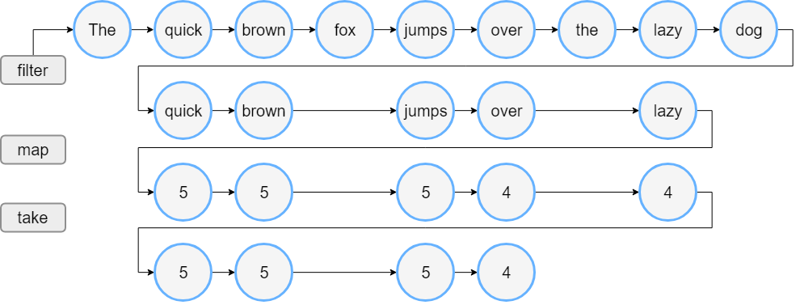
Operating on collections vs sequences
val words = "The quick brown fox jumps over the lazy dog".split(" ")
val lengthsList = words.filter { it.length > 3 }
.map { it.length }
.take(4)

Slide 82
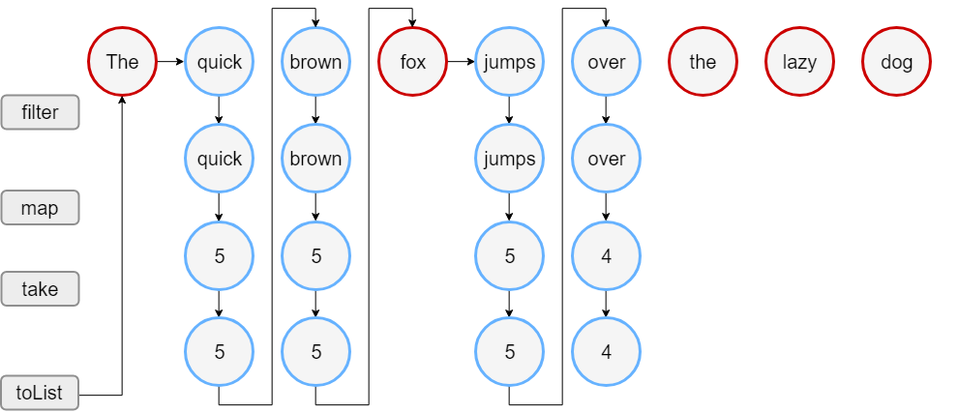
Operating on collections vs sequences
val words = "The quick brown fox jumps over the lazy dog".split(" ")
val wordsSequence = words.asSequence()
val lengthsList = wordsSequence.filter {it.length > 3 }
.map { it.length }
.take(4)
.toList() //consumer

Slide 83

Learning more
Diving Deeper Into Kotlin Standard Library Functions
https://blog.kiprosh.com/kotlin-standard-library-functions/
Kotlin Nitpicks: Language and Standard Library
https://niklaslochschmidt.com/blog/2022/kotlin-nitpicks-language-and-stdlib/
Kotlin’s way to make DSLs and many standard library functions work
https://proandroiddev.com/kotlins-way-to-make-dsls-and-many-standard-library-functions-work-a8e750c38628

